Slide 1
Owlbox Applications
Prem Kurumpanai

Slide 2
Potential Applications
Internal
Retrofit Blind-Spot monitoring to older vehicles
Average Speed of Traffic
Lane Change Warning
Traffic Signal Status
External
Velocity-based Stop Sign
Speed Limit Signs

Slide 3
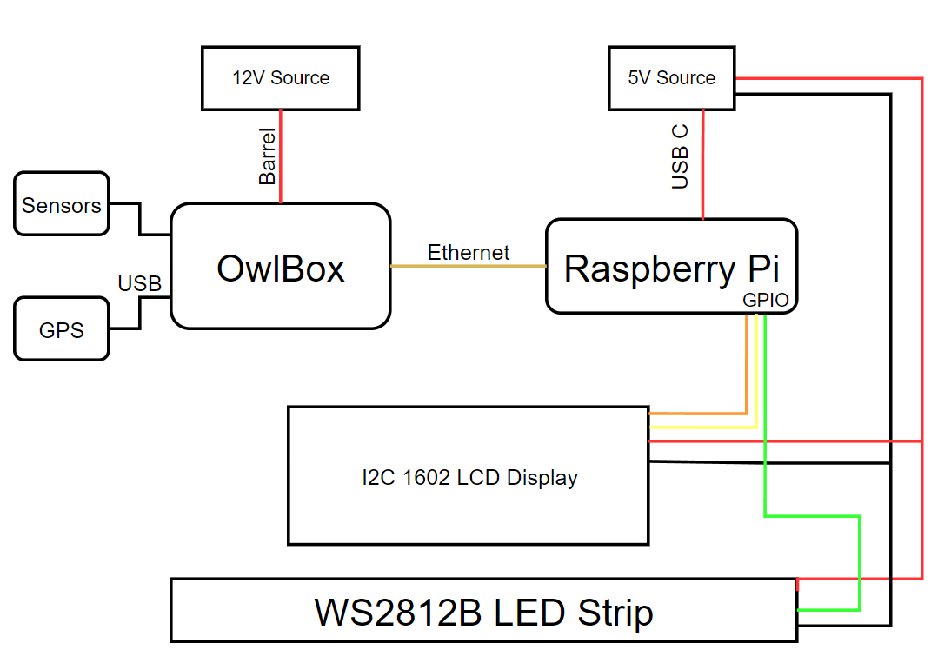
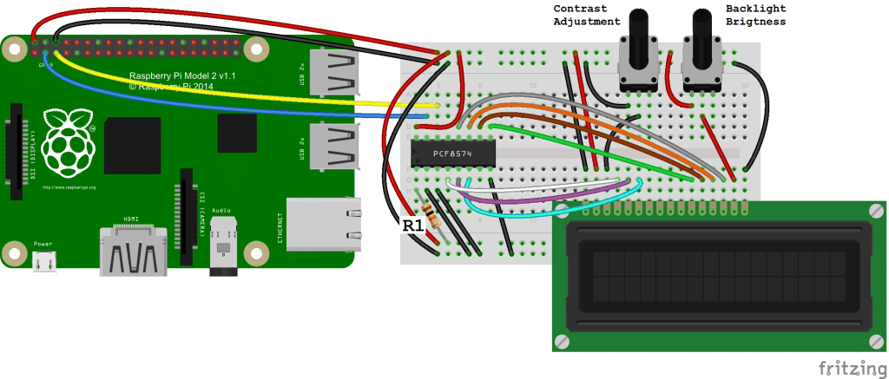
Internal: Schematic

Slide 4
Internal: Bill of Materials
Owlbox & 12V Power Supply
Raspberry Pi 3/4 (Model B) & 5V Power Supply
Ethernet Cable
I2C 1602 LCD Display
WS2812B LED Strip
SN74AHCT125 Level Converting Chip

Slide 5
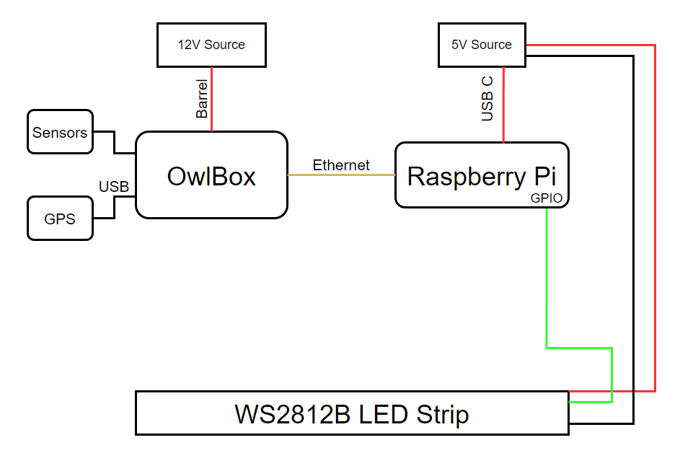
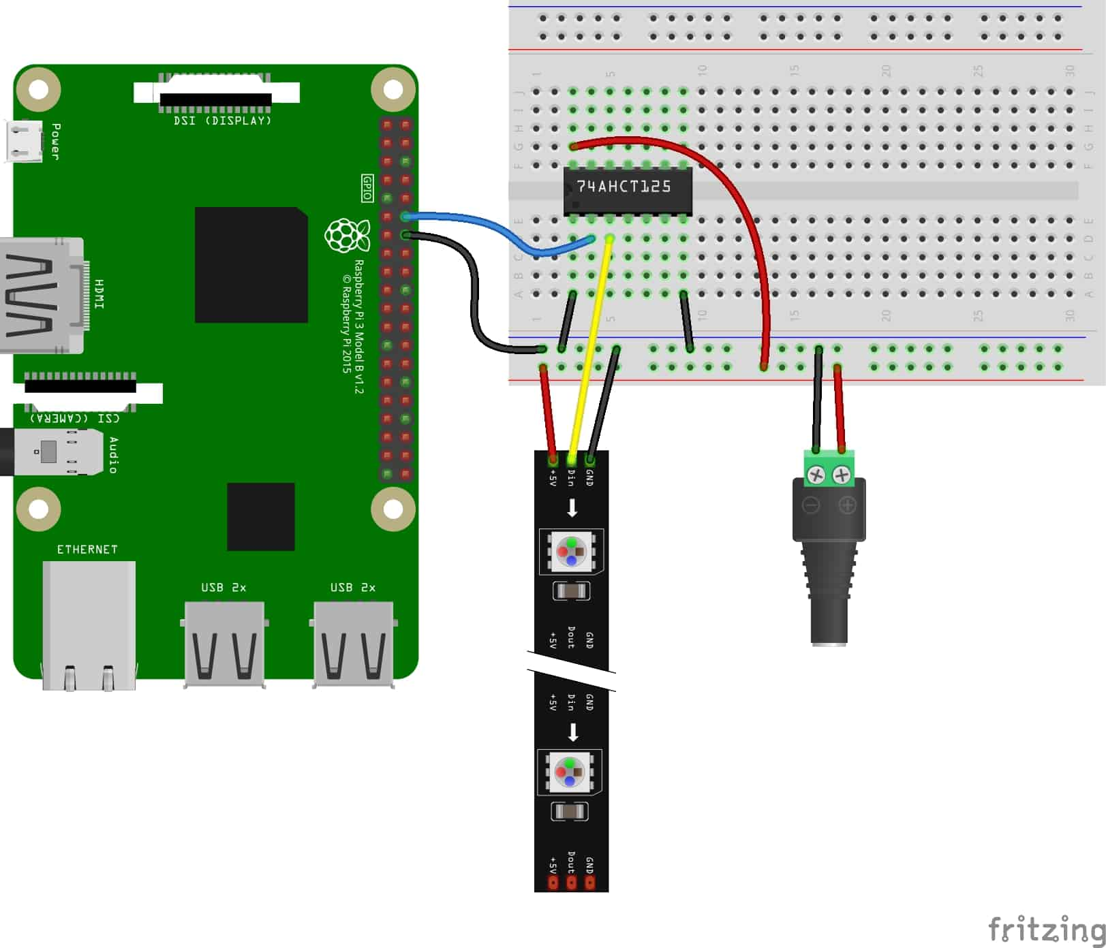
External: Schematic

Slide 6
Libraries
Python
Socket
Rpi_ws281x
I2c-tools (SMBus)

